Slide 1

Disease Prediction System: Data Cleaning, Encoding, and Model Training
Presented By : Kruti Parikh
Shrutika Netke
Guided By : Prof. Roselyne Tchoua

Slide 2

What is disease prediction system and its benefits
A system that utilizes machine learning to predict diseases based on a person's symptoms.
It analyzes data patterns to identify relationships between symptoms and diseases.
BENEFITS:
Faster initial diagnosis.
Improved accuracy in identifying potential illnesses
Can prioritize high-risk cases for further investigation

Slide 3
Setting Up the Environment: Importing Dependencies
Before diving into the data, we need to import essential libraries to manipulate and analyze it.
We'll be using libraries like :
Pandas for data manipulation
NumPy for numerical computations
Scikit-learn for machine learning tasks

Slide 4
PROJECT SETUP
Dataset Used :
We'll be using a dataset from Kaggle, a popular platform for data science and machine learning.
Link: https://www.kaggle.com/datasets/neelima98/disease-prediction-using-machine-learning
The Disease Prediction - Kaggle dataset contains:
4920 rows of records and 133 columns of attributes.
The data types of the attributes consist of :
1 qualitative discrete categorical,
132 quantitative discrete binary,
1 quantitative continuous numerical float with 64 digits placings.

Slide 5
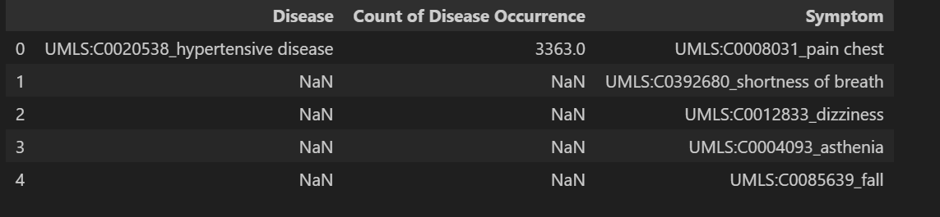
Loading the Raw Dataset & Data Cleaning
Now, we'll load the raw dataset containing information about diseases and their corresponding symptoms. We are using the .xlsx file format.
Data cleaning is essential to ensure the quality of our analysis. In this step, we'll address missing values (represented as NaN) in the dataset.
We'll utilize a technique called 'forward fill' to replace missing values with the values from the immediately preceding rows.
Missing values (NaN) can negatively impact machine learning algorithms. We need to address them to ensure our model is trained on a complete and accurate dataset.

Slide 6
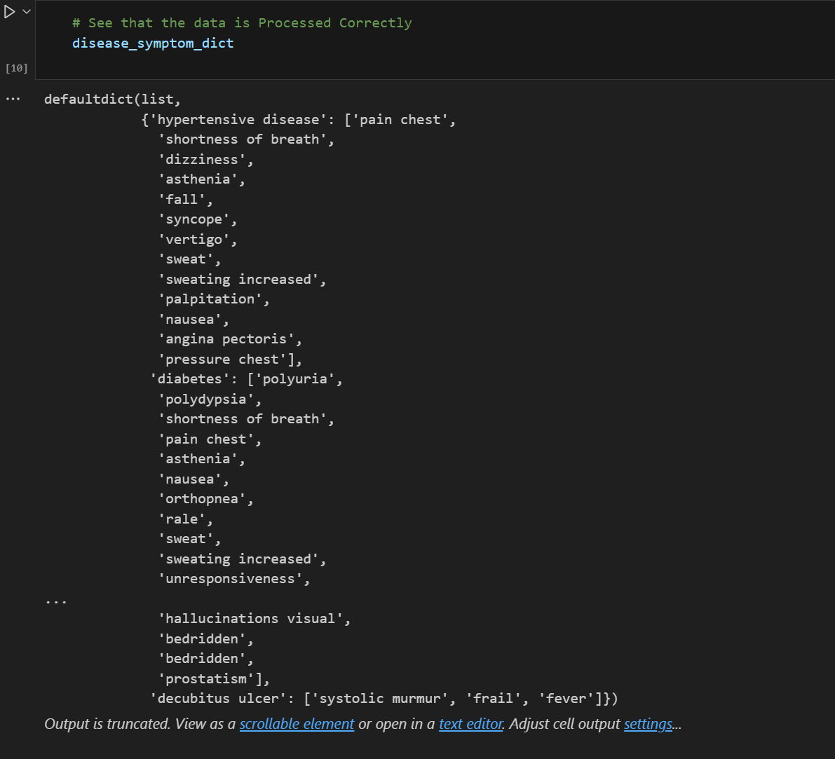
Data Preprocessing: Standardizing Disease and Symptom Names
This step involves preprocessing the disease and symptom names in our dataset to ensure consistency and facilitate better analysis.
These are the specific processing tasks that we are performing to ensure easy handling of data :
We’ll replace special characters with underscores ( _ ).
We'll split compound disease names based on delimiters (like '_’).
We'll potentially remove unnecessary parts from the names
This dictionary (disease_symptom_dict) demonstrates the processed disease names as keys
and their corresponding symptom lists as values.

Slide 7
Building the Disease-Symptom Dictionary
In this step, we construct a dictionary that maps each disease to its corresponding symptoms and their occurrence counts.
This dictionary will be a crucial data structure for building our disease prediction model.
This dictionary facilitates efficient access to symptom information for each disease. It will allow us to train a model that can predict potential diseases based on a set of symptoms.
We leverage the information extracted during name processing to build the dictionary. Disease names become keys, and their corresponding symptom lists with occurrence counts become values.
The “disease_symptom_count” dictionary demonstrates this structure, where each disease has its total occurrence count as the value.

Slide 8
Preserving Progress: Saving Cleaned Data to CSV
We consolidate our efforts by saving the cleaned data into a CSV file for future use and collaboration.
Storing data in CSV format ensures accessibility, compatibility, and ease of sharing for later analysis or model building.
Saving cleaned data is essential for preserving our progress, enabling us to resume analysis or share it with others without redoing the cleaning steps.
The code iterates through the disease-symptom dictionary, writing each disease, its corresponding symptoms, and occurrence counts as rows in a CSV file.
While we've addressed missing values during initial cleaning, we might perform a final check for empty values before proceeding.
Although we previously handled missing values with forward fill, there's a chance there might still be rows with entirely empty cells after processing.
We can then verify the number of unique symptoms (n_unique) after this step to ensure we have a complete dataset for further analysis.

Slide 9
Converting Categorical Variables for Machine Learning: One-Hot Encoding
Before machine learning, we transform categorical variables like symptom names using one-hot encoding to make them numerical and understandable for algorithms.
Many machine learning algorithms only operate on numerical data. Encoding categorical variables transforms them into numerical formats for analysis.
One-hot encoding creates a binary vector for each category, where only the position representing that category is 1 (and all others are 0).
One-hot encoding is a technique used to represent categorical variables as binary vectors. In one-hot encoding, each category is represented as a binary vector where all elements are zero except for the index corresponding to the category, which is set to one.
For example, consider a categorical variable "Color" with three categories: "Red", "Green", and "Blue". After one-hot encoding, the categories are represented as follows:
"Red" is represented as [1, 0, 0]
"Green" is represented as [0, 1, 0]
"Blue" is represented as [0, 0, 1]

Slide 10
Building the Training Dataset
In this step, we combine the processed features (encoded symptoms) with the disease labels to create the final training dataset for our machine learning model.
The training dataset will serve as the foundation for training our disease prediction model. It needs to represent the relationship between symptom information (features) and the corresponding diseases (labels).
We've discussed the concept of combining encoded features with disease labels. Now, let's delve into the specific steps for our data.
Since each disease can have multiple symptoms, directly combining them might lead to a sparse matrix with many zero values.
To address this, we're using a groupby operation on the 'disease' column in the Data Frame df_concat.
This groups all symptom occurrences by their corresponding disease.
We then use the sum() function to aggregate the symptom occurrences for each disease.

Slide 11
Building the Disease Predictor: Training a Decision Tree Classifier
Now we're ready to train a machine learning model to identify potential diseases based on a set of symptoms.
We'll use a decision tree classifier, which works by building a tree-like structure to classify data.
Machine learning allows us to build models that can learn from data and make predictions on new, unseen data.
A decision tree classifier is a type of machine learning model that uses a tree structure to make decisions. It asks a series of questions about the symptoms (features) to arrive at a final prediction (disease).
We first split the data into training and testing sets (train_test_split). The training data will be used to build the model, and the testing data will be used to evaluate its performance.
Then, we create a Decision Tree Classifier object (dt) and train it on the training data (dt.fit(X_train, y_train)).
Finally, we can evaluate the model's accuracy on the entire dataset (clf_dt.score(X, y)) to get a preliminary idea of how well it performs.

Slide 12
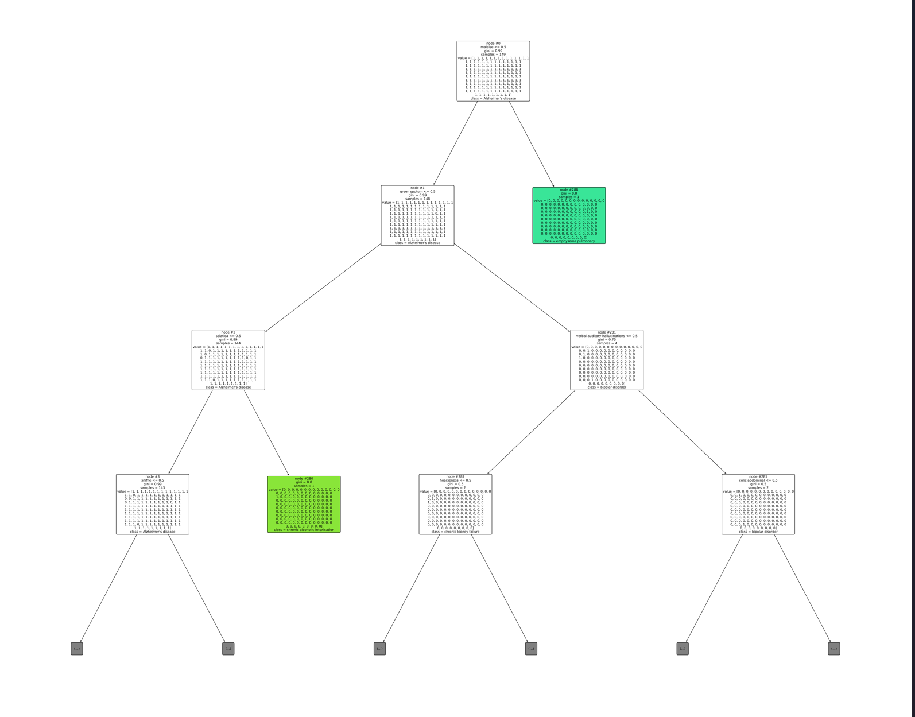
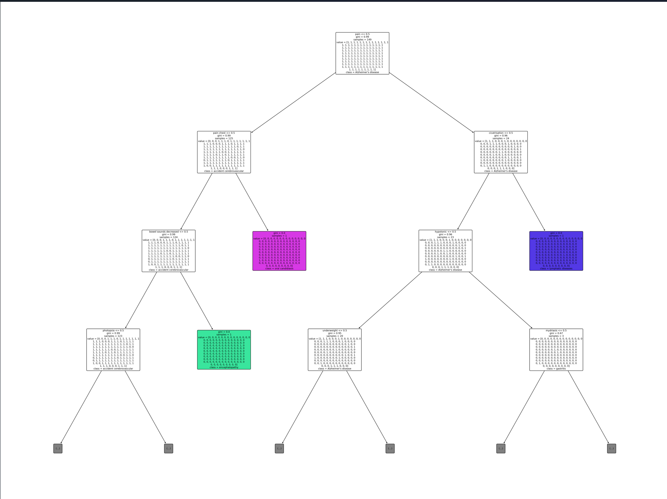
Tree visualization
Tree visualization improved

Slide 13
Assessing Our Model's Performance
After training the model, we need to evaluate its effectiveness in predicting diseases based on unseen data.
We'll use various metrics like accuracy, precision, recall, and F1-score to assess the model's performance.
Model Performance Summary:
Overall Accuracy: 97.00% - This metric tells us that the model correctly predicted the disease for 97% of the cases in the test set. It's a good overall indicator of model performance.
Macro Average Precision, Recall, and F1-Score: 94.00% - These metrics consider the performance for each disease class individually and then take an average. A value of 94% indicates the model performs well on average across all diseases.
Weighted Average Precision, Recall, and F1-Score: 97.00% - Weighted metrics consider the number of cases for each disease class when calculating the average. In this case, the high weighted average scores are similar to the overall accuracy, suggesting the model performs well even for less frequent diseases.

Slide 14

Conclusion
Building a Disease Prediction System: A Promising Step
Key Achievements:
Developed a machine learning model to predict diseases based on symptom data.
Achieved high overall accuracy (97%) and balanced performance across most diseases.
Demonstrated the potential to assist healthcare professionals in the diagnostic process.
Future Directions:
Refine the model to improve accuracy, particularly for specific disease categories.
Integrate the system into a user-friendly platform for wider accessibility.
Conduct further testing and validation in a clinical setting.
Overall, this project serves as a promising step towards utilizing machine learning for disease diagnosis. With ongoing development and collaboration with medical professionals, this system has the potential to enhance healthcare efficiency and improve patient outcomes.

